Slide 1

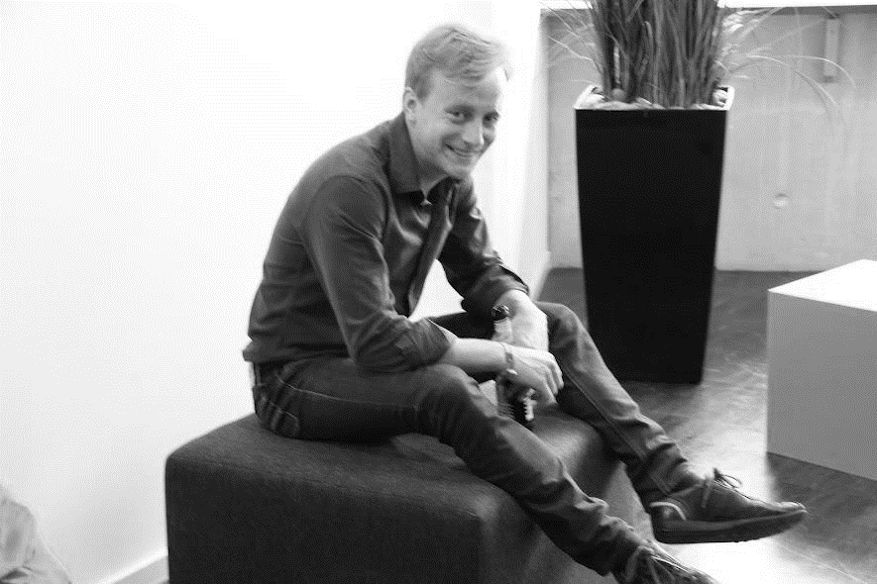
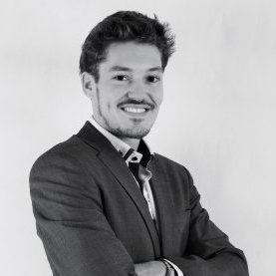
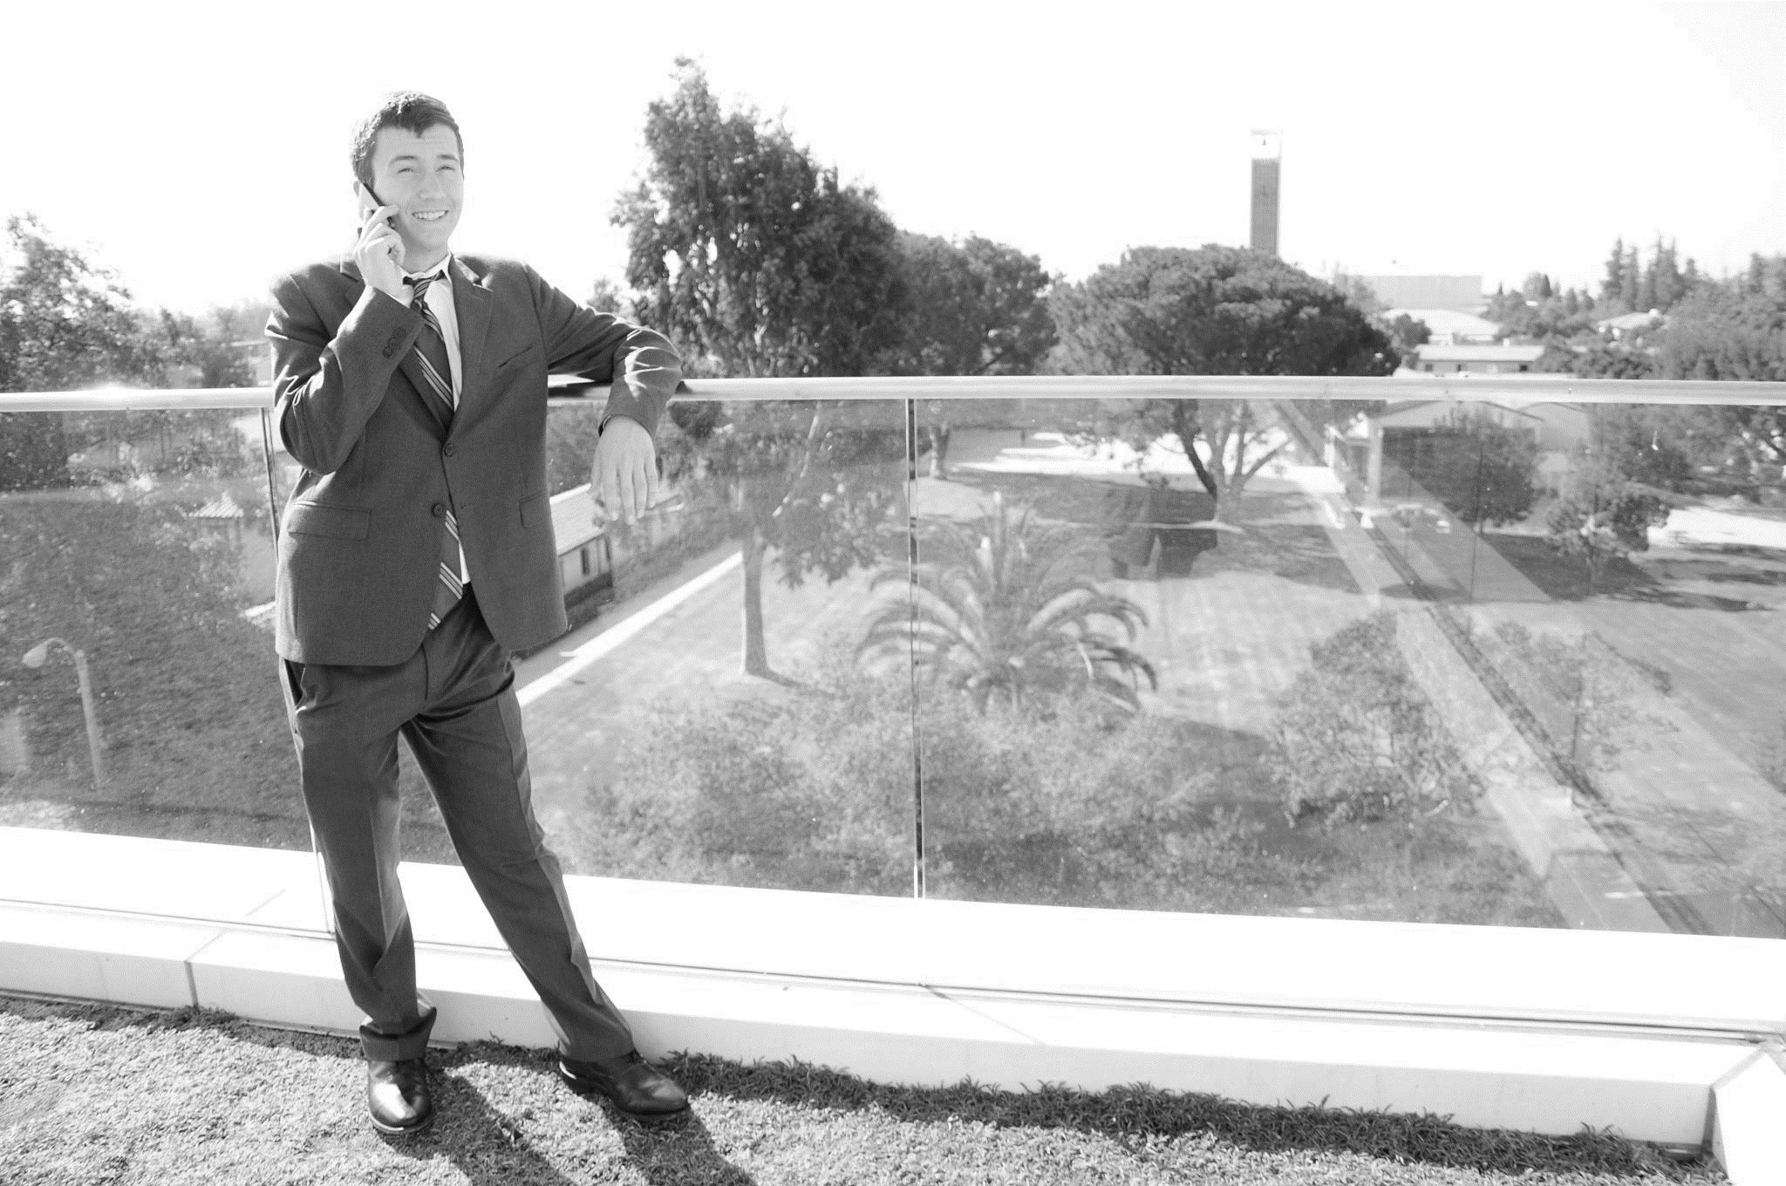
Team Kairos
Alex Kern (US) Magnus Paaske-Petersen (DK)
Bjørn Broby Glavind (DK) Rich Zajac (US)
Hacker extraordinaire
Cal Hacks, NASA, Apple, Hackathon Hackers, Kairos
Hacker extraordinaire
Ampion Africa, Airtame, Venture Cup, Kairos
Business Developer
IB Case Competition, Oxford, Halal Tech Venture Builder, Kairos
Business Developer
X Prize, Liftoff Ventures, NexDrive, Vroomeo, Kairos

Slide 2
2
Challenges
Smart Lifestyle: Optimize the Urban Park Experience
Smart Living: Accelerating Connected Cars
Smart Health: Creating the Ultimate in Integrated Healthcare

Slide 3

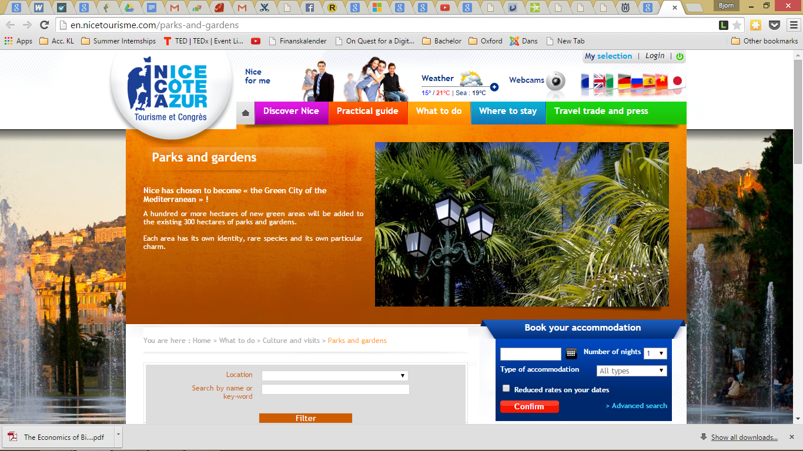
3
Green Nice
Increased Health
Access to green areas promotes exercise and releases stress.
Increased Property Value
Attractive green spaces raise property value.
Decreased Heat
Green spaces help regulate the temperature and climate of cities.
Better Community Spirit
Access to a good green area has a positive effect on the neighborhood.
Better Air
Green spaces filter and provide cleaner and less polluted air.

Slide 4
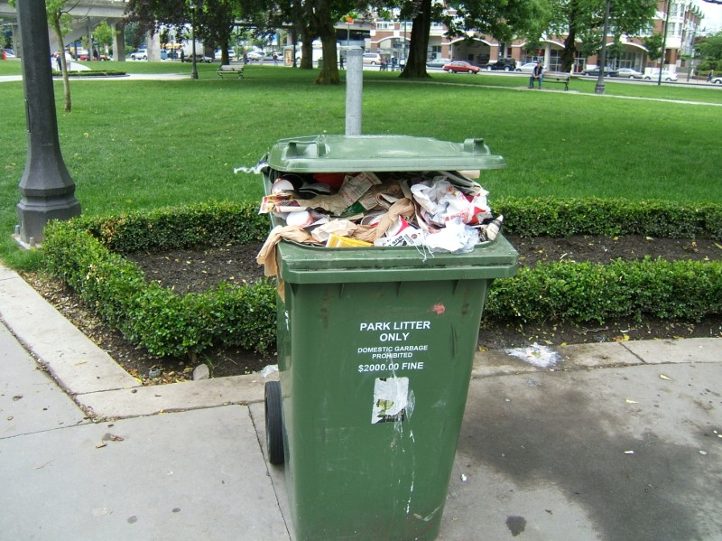
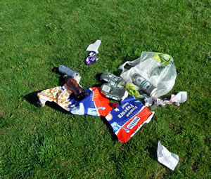
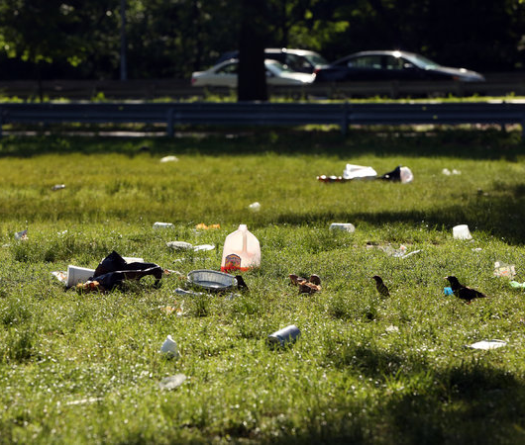
4
Green spaces get dirty

Slide 5
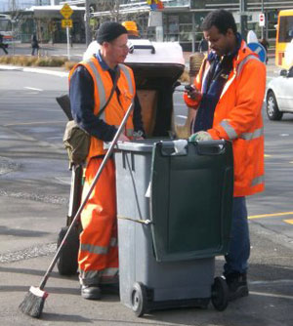
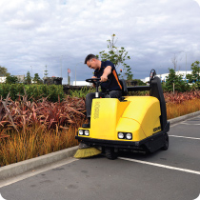
5
Green spaces imply costs

Slide 6
7
Introducing…

Slide 7
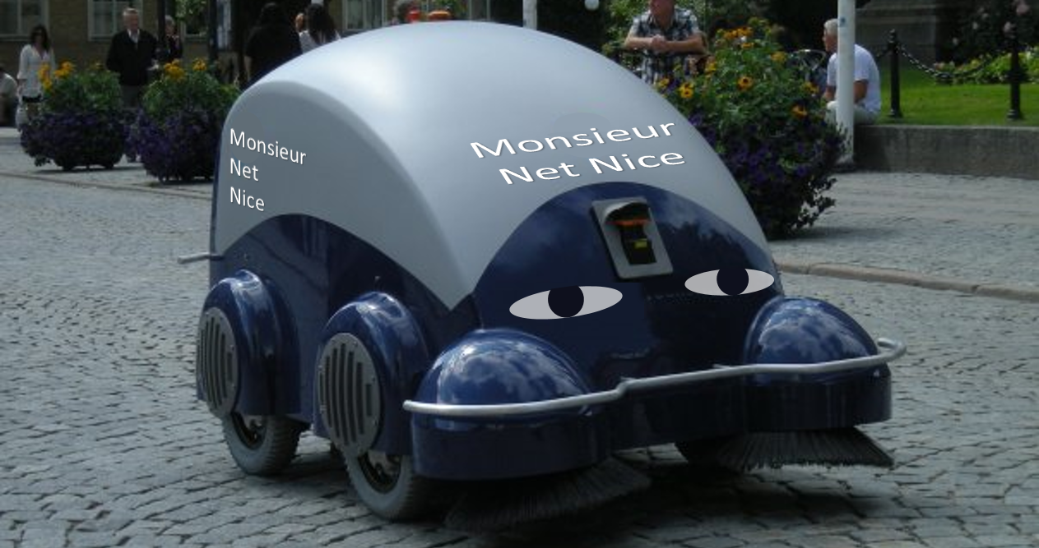

Slide 8
9
Challenges
Smart Lifestyle: Optimize the Urban Park Experience
Smart Living: Accelerating Connected Cars
Smart Health: Creating the Ultimate in Integrated Healthcare

Slide 9
DEMO
http://bit.ly/internetofparks

Slide 10



Thank you for your time
and attention!
Team Kairos
Alex Kern
Magnus Paaske-Petersen
Bjørn Broby Glavind
Rich Zajac

